Slide 1

Basic Details of the Team and Problem Statement
Ministry: Ministry of Home Affairs
PS Code: 1308 Problem Statement Title: Threat zone of an explosion particularly in oil and gas handling industries or refineries Team Name: Explo-Safety Squad Team Leader Name: Aditya Mukherjee Institute Code (AISHE): U-0577 Institute Name: National Institute of Technology, Durgapur
Theme Name: DISASTER MANAGEMENT

Slide 2
Overview of Solution
This software improves plant safety and emergency response capabilities by integrating satellite data for exact plant location and layout identification, in addition to local danger containment measures. This investigation is extended within a 5 to 10 km radius, incorporating villages and nearby plants. Access to critical data such as stream information and P&ID diagrams enables extensive plant location analysis and equipment mapping. It computes the Probability of Explosion using parameters such as LEL and HEL to determine potential hazard timings. The formulation of consequences includes TNT equivalent calculations and harmful substance release patterns. Notably, generative AI automates the generation of emergency response plans based on threat levels and plant layouts, expediting response efforts. Impact assessment combines Probability of Explosion and consequence calculations for a thorough risk evaluation that improves safety and operational efficiency.

Slide 3
Obtaining satellite data for complete plant geographic locations
Complete layout of the plant and geographic locations: Use satellite imagery and GPS to create a detailed map of the plant and its surroundings, identifying all hazardous locations and critical infrastructure.
Hazard containing steps taken by the plant: Develop a database of all hazard containing steps, including type, location, and steps taken to contain.
What is in the surroundings (5 km to 10 km radius): Use satellite imagery to identify villages, plants, and other critical infrastructure within a 5 km to 10 km radius of the plant.
Potential challenge: Accessing the layout of the plant for sections where exact details are not available: Use a combination of satellite imagery, publicly available data, and expert knowledge to estimate the layout of the plant for sections where exact details are not available. The software could also be designed to allow users to input additional information about the section of the plant as it becomes available.

Slide 4
Accessing the stream data, P&ID diagrams for more detailed plant location analysis
Image processing: Satellite imagery can be processed to identify major explosive or hazardous equipments. This can be done using a variety of techniques, such as object detection and classification.
Natural language processing: P&ID diagrams can be parsed using natural language processing techniques to extract information about the equipment, such as its location and specifications.
Data integration: The data from the satellite imagery and P&ID diagrams can be integrated to create a database that contains information about all of the major explosive or hazardous equipments in the plant, as well as their locations and specifications.

Slide 5
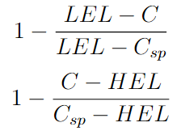
Calculation of Explosion Probability
The LEL is the minimum concentration of a flammable gas or vapor in air that can be ignited.
The HEL is the maximum concentration of a flammable gas or vapor in air that can be ignited.
The probability of explosion can be calculated using the following equations:
C = Predicted concentration of the explosive material
Csp = set point for the process stream that is maintained by the control system.
Based on the calculated probability of explosion, we can take appropriate preventive measures. For example, if the probability of explosion is high, we may need to evacuate the area or take other steps to protect people and property.
The above calculation can be used to estimate the probability of explosion in a variety of situations. This information can be used to take appropriate preventive measures.

Slide 6
Consequence formulation
TNT Equivalent: Quantifies explosive power relative to TNT, aiding in power assessment.
Distance from Ground Zero (r): Crucial in gauging threat levels, varies with proximity.
Focus: Emphasis on ground-level explosions within oil and gas complexes.
Toxic Material Release: Integral in post-explosion consequence analysis.
Threat Zone Assessment: Computed using TNT equivalent, 'r' distance, and toxic material dispersion.
Impact Factors: Greater TNT equivalent, increased 'r,' and extensive toxic release expand the threat zone.

Slide 7
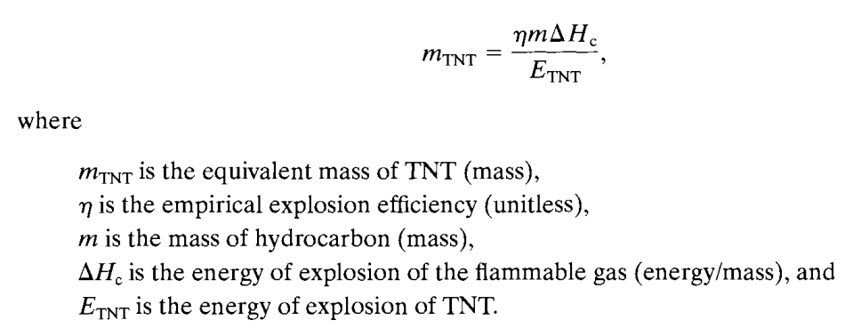

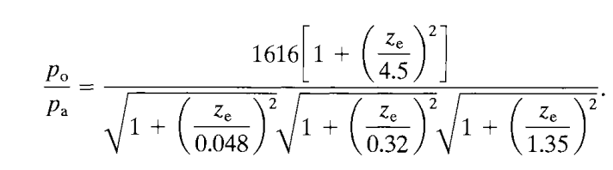

Notes:
m, composition, temperature, Cp to calculate del Hc, Qm (flowrate or mass).
To calculate sigma(s):
- Wind speed
- weather conditions
- time of blast

Slide 8
Resultant Impact Calculation
Impact: The potential damage caused by an explosion, including the loss of life, property, and environmental damage.
The resultant impact of an explosion is calculated by
P(Explosion) denotes probability of Explosion
Consequences denotes the quantified damages that occurred due to explosion.
To better understand the risks posed by explosions and develop more effective strategies for preventing and mitigating their impact, we can also consider FAR, fatality rate, and OSHA incidence rate.

Slide 9
Generative AI for Emergency Response Plans
Objective: Automate emergency response plan creation with generative AI.
Methods:
NLP & Transformer-Based Models: Use advanced NLP models like GPT-3 for text generation.
Data Integration: Combine threat data, facility layouts, and guidelines.
Conditional Text Generation: Create responses based on conditions like threat levels.
Validation: Ensure plans comply with safety standards.
Deployment: Integrate into emergency response systems for on-demand planning.
Continuous Learning: Update with evolving threat data and best practices for accuracy.

Slide 10
Use Cases and Dependencies
Use Cases
Dependencies and Tech-Stack
The main issue or mistake in the ExxonMobil scenario that we encountered was caused by some operators or individuals neglecting the washout of the regenerator. The explosion occurs as an aftermath of their forgetting or inability to measure whether the hydrocarbon is under HEL or otherwise. In this instance, we can forecast the likelihood of the EL that we must uphold, allowing us to prevent or foresee such a scenario of explosion.
Styrene flowed throughout the area during the Vizag blast, causing significant devastation. But in this case, we can anticipate the area that will be most harmed by using the FAR, OSHA FATALITY RATE, and m_{TNT}, and finding the radius for waves and hazardous waves. This allows us to recommend precautions or suggest actions that can be taken to prevent losses.
By predicting the likelihood of an explosion and the area that will be most affected, we can help to prevent disasters and save lives.
Dependencies:
Updated Datasets
High quality sensor readings
Descent computational Power and high speed internet connection for smooth loading of 3D models in real time.
Tech Stack:
Programming language: Python, C++, or Java
CFD software: OpenFOAM, ANSYS Fluent, or STAR-CCM+
PHA-PRO software: PHAWare or PHAWorks
Web framework: Django, Flask, or Spring Boot
Database: PostgreSQL, MySQL, or Oracle
Cloud platform: AWS, Azure, or Google Cloud Platform

Slide 11
Team Member Details
Team Leader Name: Aditya Mukherjee
Branch: B.Tech. Stream: Chemical Engineering (CHE) Year: IV
Team Member 1 Name: Adrija Dhar
Branch :B.Tech. Stream: Chemical Engineering (CHE) Year: III
Team Member 2 Name: Anindya Paul
Branch :B.Tech. Stream: Chemical Engineering (CHE) Year: IV
Team Member 3 Name: Sujaan Mookherjee
Branch :B.Tech. Stream: Chemical Engineering (CHE) Year: IV
Team Member 4 Name: Ayan Sil
Branch :B.Tech. Stream: Chemical Engineering (CHE) Year: IV
Team Member 5 Name: Ananya Pal
Branch :B.Tech. + M.Tech. Stream: Chemical Engineering (CHE) Year: III
Team Mentor 1 Name: Sandip Kumar Lahiri
Category (Academic/Industry): Expertise (AI/ML/Blockchain etc): Domain Experience (in years):
Team Mentor 2 Name: Abhiram Hens
Category (Academic/Industry): Expertise (AI/ML/Blockchain etc): Domain Experience (in years):

